Slide 1

CORFU CABLE REPAIR
  Technical Method Statement – CLV Nexans Skagerrak.
25-oct-2025

Slide 2

Summary
General
Fault Overview
Cable System
Repair Method
Tentative Time Schedule
CS Skagerrak

Slide 3
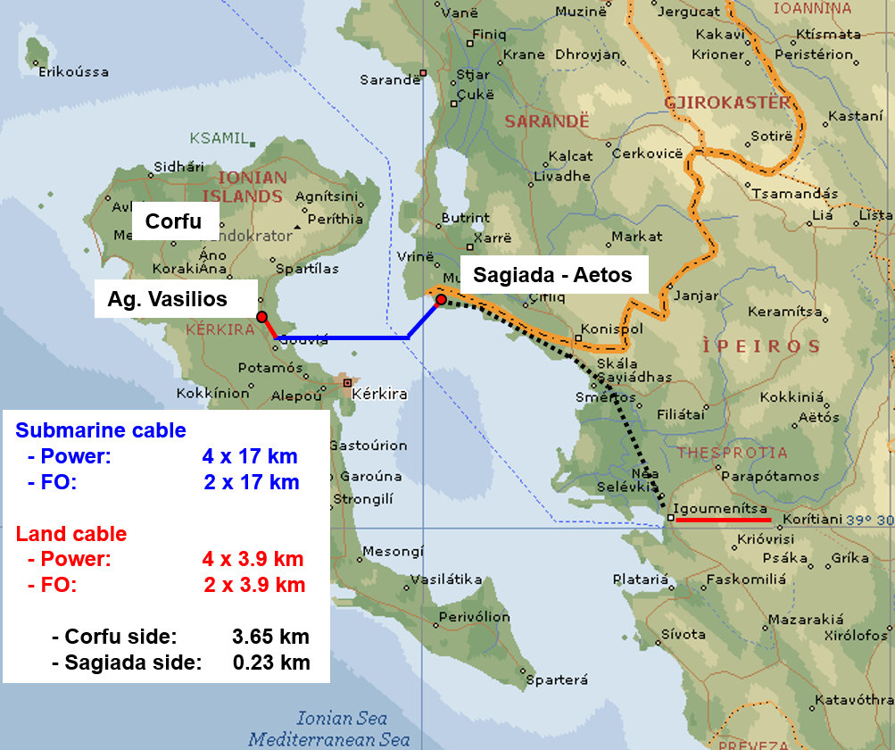
General
Corfu cable repair/method statement
Corfu cable system
    The CORFU – Mainland Project is a turnkey Project that was awarded by Nexans and comprisied of disign, supply and installation of the power & communication link between the Greek Islad Corfu (Kerkyra) and Greek mainland. Corfu is located off the coast of Greece and Albania.
    The length of the installed cables are as follow:
    Cable no1: Approx. Total length installed: 16805 meters.
    Cable no2: Approx. Total length installed: 16873 meters.
    Cable no3: Approx. Total length installed: 16946 meters.
    Cable no4: Approx. Total length installed: 17104 meters.
    *Oil filled, OKRA 150kV 4x400mm2 – Cu

Slide 4
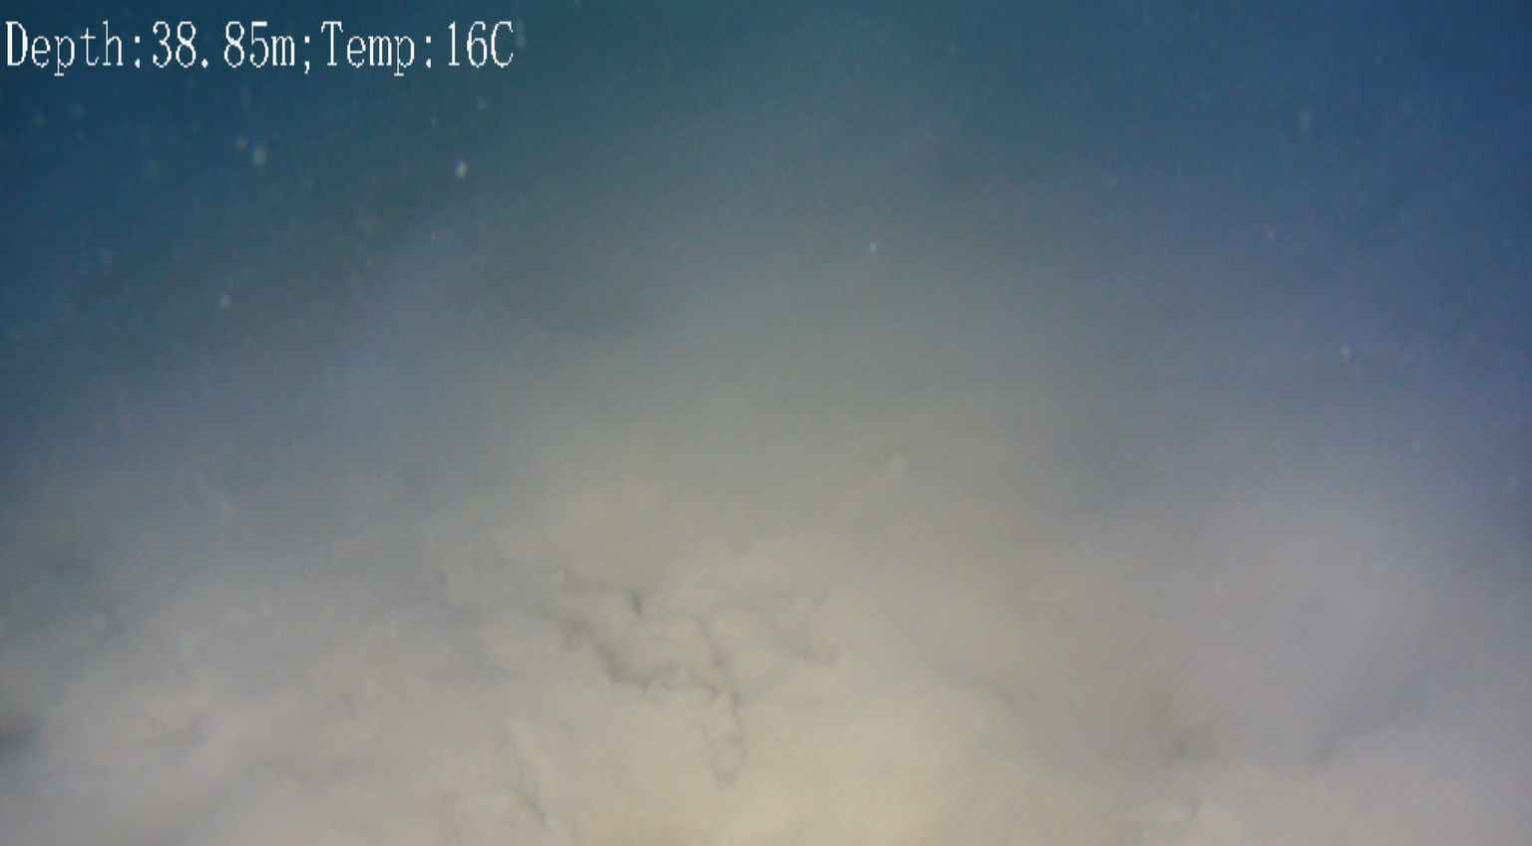
Fault Overview
Corfu cable repair/method statement
    The initial tests, suggested that the fault location is on the submarine cable about 4km away from Corfu shore.
    The damage location was confirmed during the first repair campaign in March/April -25.
    The fault was cut and removed, and the open cable ends were sealed off. Then the first repair cable length was installed with one repair joint, leaving the remaining repair for a second campaign - to install another 500m repair cable length and two repair joints
    After final repair in second campaign, the cable will be protected by Nexans Capjet burial system.
ROV inspection performed 2024-07-02 - 12:57

Slide 5
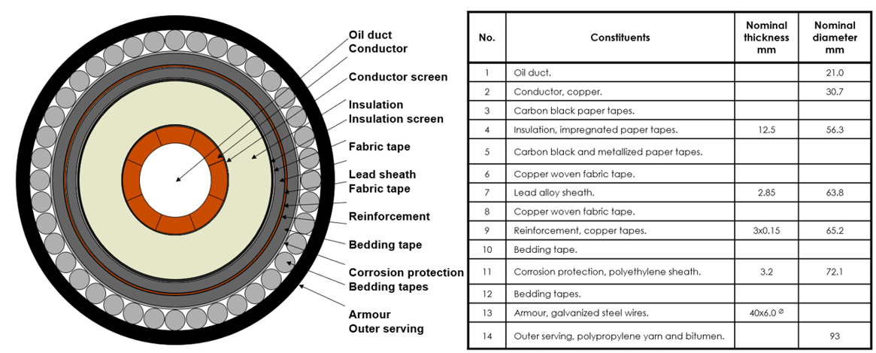
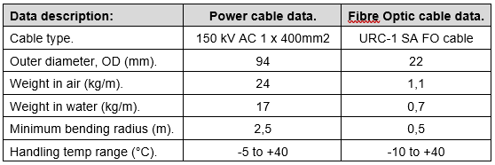
CORFU – Cable System
Corfu cable repair/method statement
    CORFU submarine cable is an oil filled, OKRA 150kV 4x400mm2 – Cu.

Slide 6
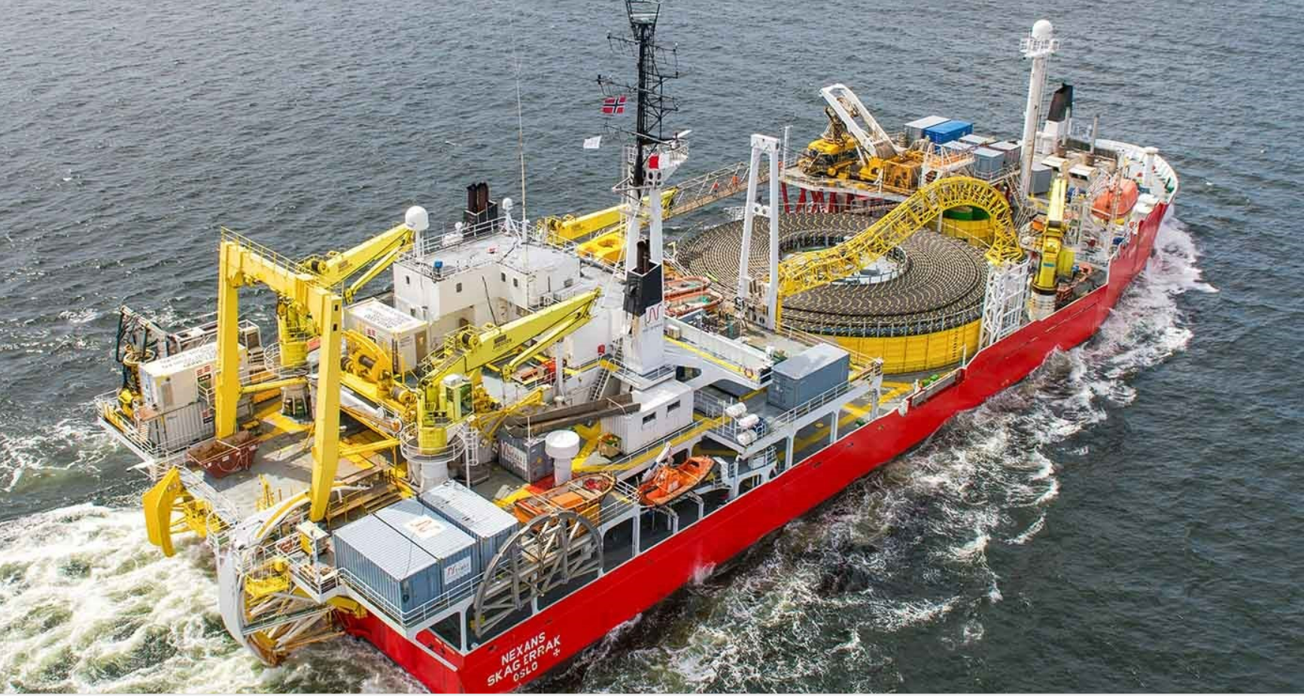
Repair Method
Corfu cable repair/method statement
    Main steps
    Vessel mobilization at suitable port.
    Loadout of Spare cable, equip. and parts at Client nominated location and transit to repair location.
    Preparatory activities on site:
      DP trials, HiPAP verifications and MBES calibrations.
      Survey at fault location and fault-finding activities (if applicable).
      De-burial activities.
    Cut the cable, recovery the first end, test, seal and laydown in preparation for the Hairpin.
    Recovery the second end, remove the damaged length, test and perform the first joint (inline).
    Overboard the repair joint and laydown the spare cable.
    Recover the first end (sealed) and perform the second joint (HP).
    Overboard the second joint and laydown in Hairpin configuration.
    Perform the burial and cable protection activities.
    As-built survey.
    Vessel demob.
    Nominated Vessel
    The nominated Vessel for the CORFU cable repair project is the CLV Nexans Skagerrak. Skagerrak has extensive track record of cable lay and repair operations including de-burial and burial. The vessel is selected to ensure that the cable is handled within its handling parameters during the complete operation from de-burial, through the cable repair up to the cable protection, to secure successful repair campaign, protection and re-energization of the Corfu cable system.

Slide 7
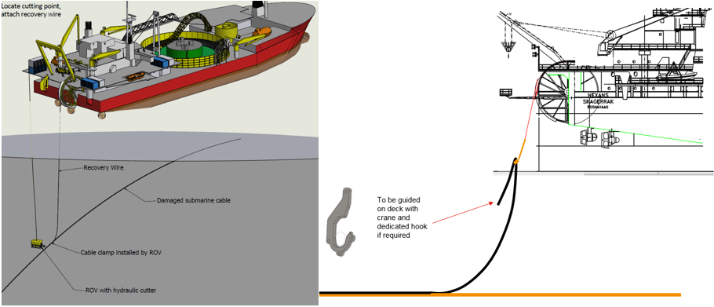
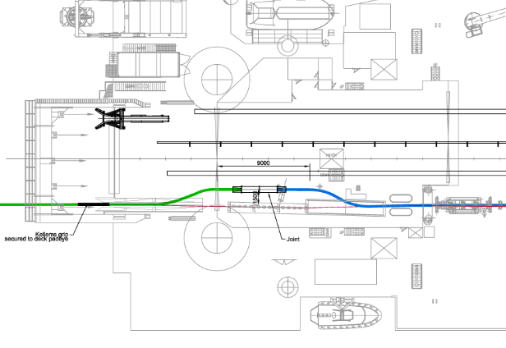
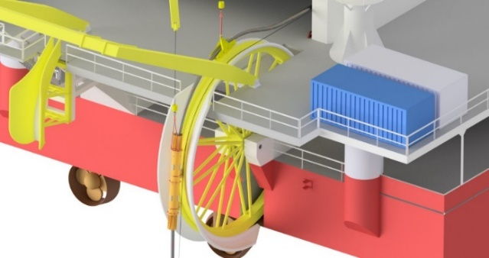
Repair Method
Corfu cable repair/method statement
    The repair method is based on the repairs joints scenarios (Inline and Hairpin joints), where certain amount of spare cable is required.
    The onshore oil pumping plants/stations (onshore terminations) on each side must be manned by qualified personnel to keep the oil flow all time (using monitoring equipment, observing and adjusting as required) and communication established with the CLV Nexans Skagerrak crew.
    Subsea cable cut, recovery and seal
    Once the cable is exposed and the fault spot is identified, the cable is cutting by using ROV dedicated tool. The first end is recovered, tested, sealed and laydown.
    2° end recovery, inline joint and laydown spare cable
    The second end is now brought to deck, the damaged cable length is confirmed and removed, and the cable is tested. First joint is performed, and the cable is layback towards the Hairpin location.

Slide 8
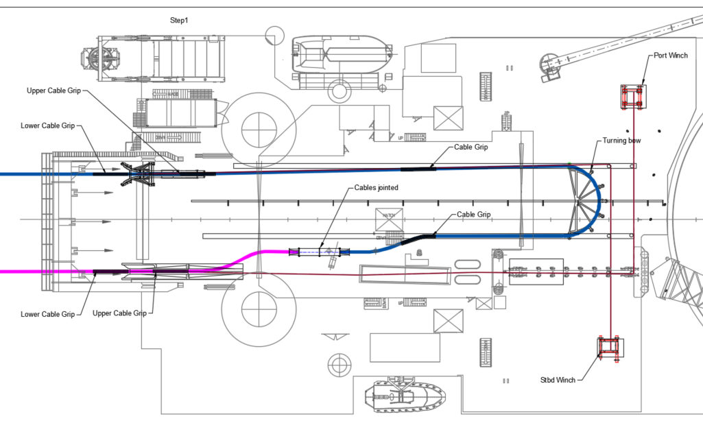
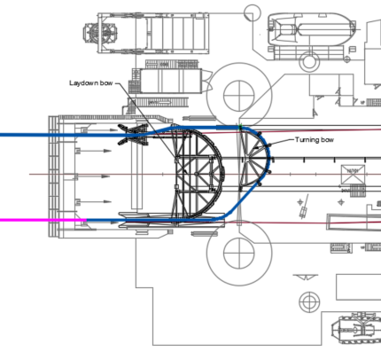
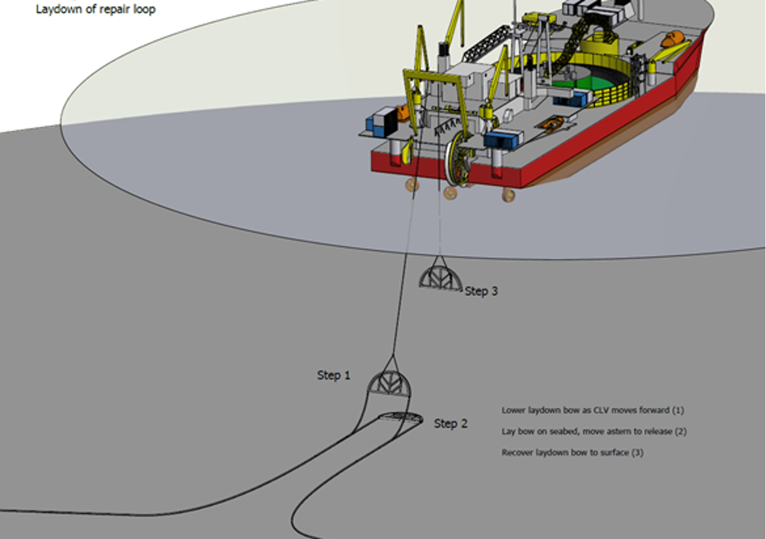
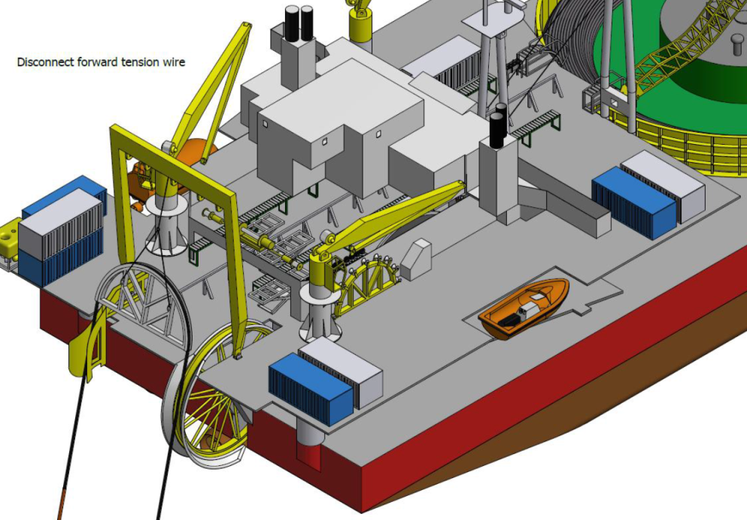
Repair Method
Corfu cable repair/method statement
    Recovery of 1° end (sealed), second joint and laydown
    After lay the spare cable, the first end (sealed) is now recovered to deck. The second joint is performed by skilled personnel. The second joint and the quadrant is now over-boarded.
    Laydown in Hairpin configuration and final activities
    The second joint and the Quadrant will be landed on seabed in Hairpin configuration.
    Final tests now can be performed, and the burial/protection of cable is performed, and the as-built survey.

Slide 9
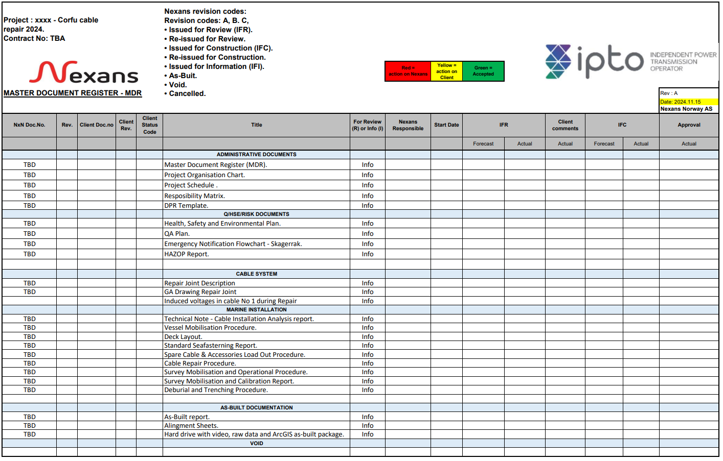
MDR
Corfu cable repair/method statement
Note: To be revised for part II campaign!

Slide 10
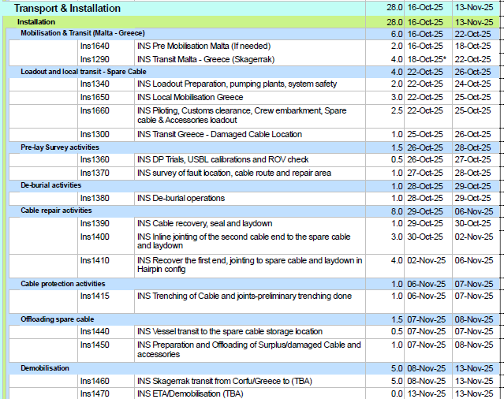
Tentative Time Schedule
Corfu cable repair/method statement
Tentative

Slide 11
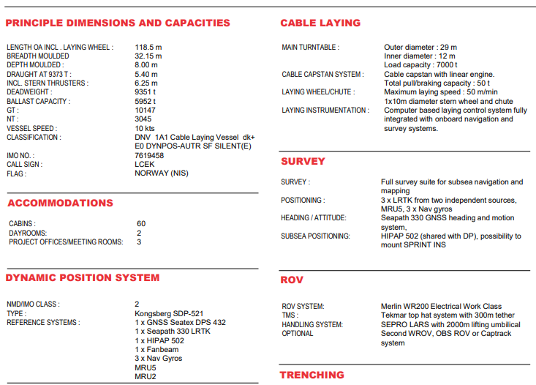
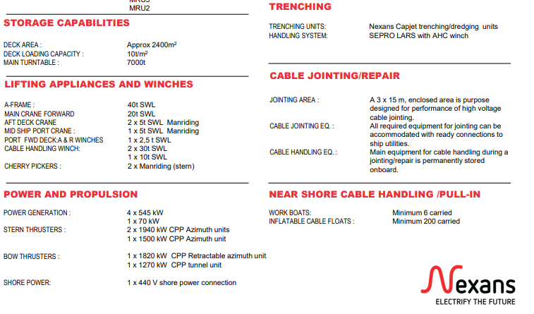
Skagerrak
Corfu cable repair/method statement

Slide 12
Thank you

