Slide 1

ATTICA-CRETE SURVEY
Technical Method Statement – CLV Nexans Skagerrak.
23-oct-2025

Slide 2

Summary
General
Survey Method
Tentative Time Schedule
CS Skagerrak

Slide 3
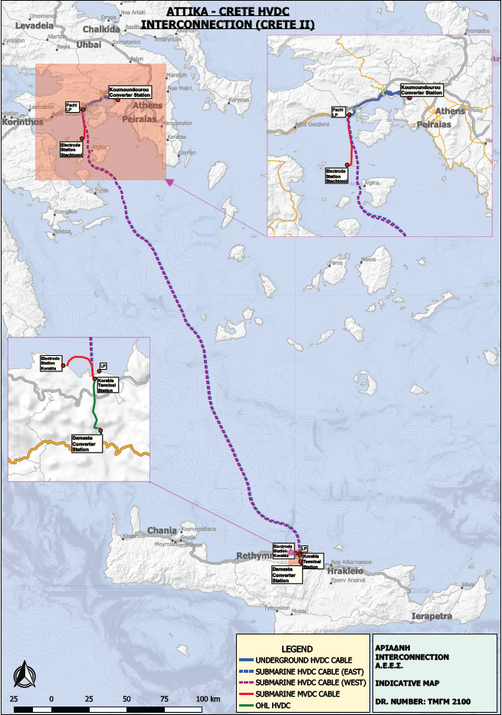
General
ATTICA-CRETE SURVEY/method statement
The attica-crete project comprised of several lots where nexans was awarded one – lot b; hvdc east pole (Attica/Pachi – Crete/Korakoi - 335 km)
Lot A; HVDC west pole (incl Electr.) Prysmian
Lot B; HVDC east pole nexans
Lot C; UG cables nkt
Lot D; FO cables prysmian
Converter stations siemens-terna

Slide 4
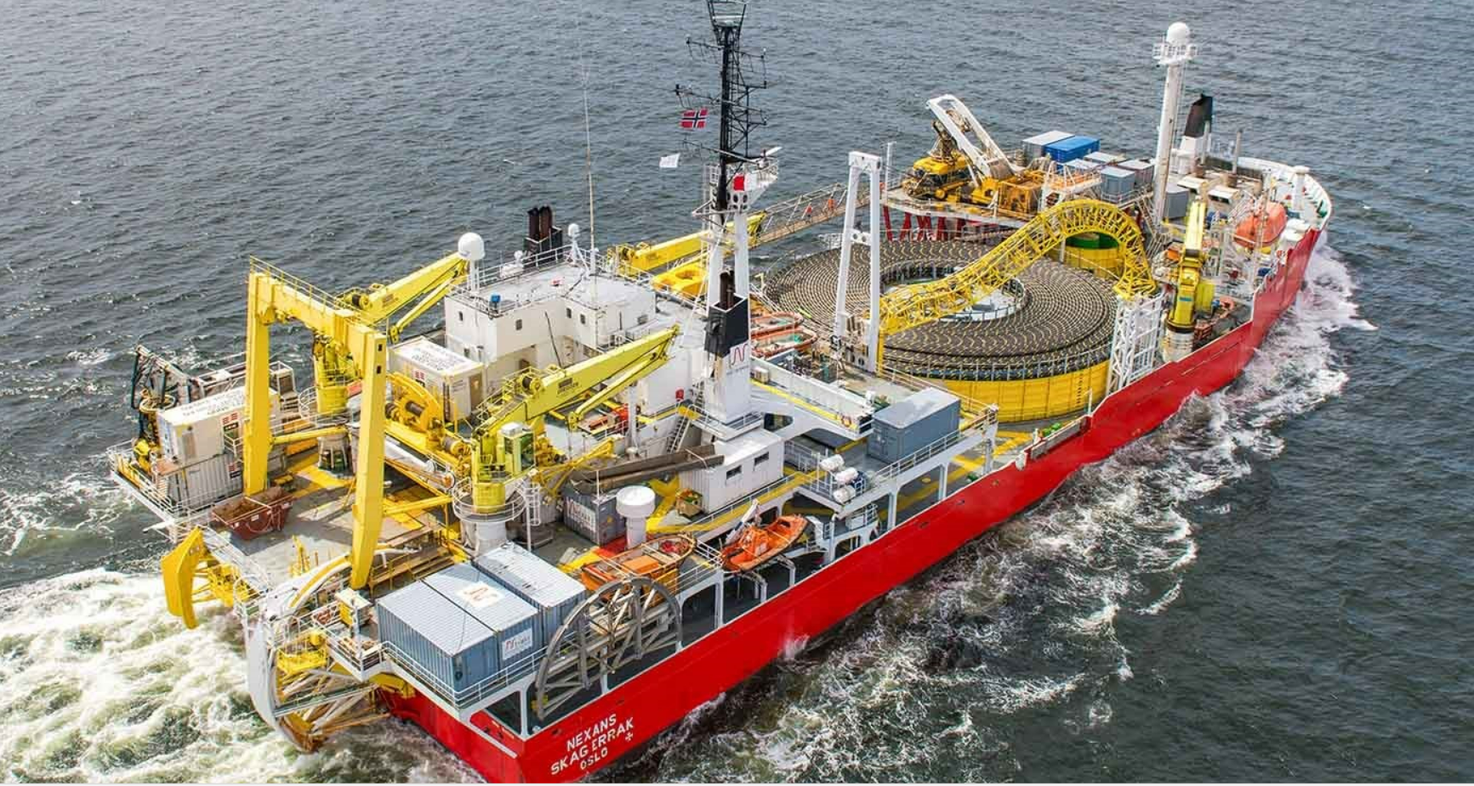
Survey Method
ATTICA-CRETE SURVEY/method statement
Nominated Vessel
The nominated Vessel for the Attica-Crete survey is the CLV Nexans Skagerrak. Skagerrak has extensive track record of cable lay, repair operations and survey work. This is a post-installation survey to check/confirm the positioning of the cable, including burial depth.
Main steps
Vessel mobilization at suitable port.
Survey of cable route with main survey equipment:
MBES (Multibeam Echosounder)
SSS (Side-Scan Sonar)
TSS440 (“Pipe tracker”)
Vessel demob.

Slide 5
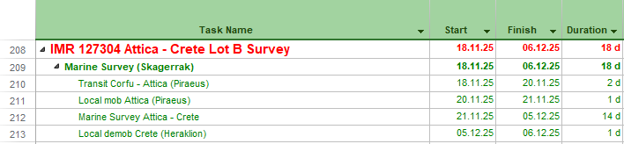
Tentative Time Schedule
ATTICA-CRETE SURVEY/method statement
Tentative

Slide 6
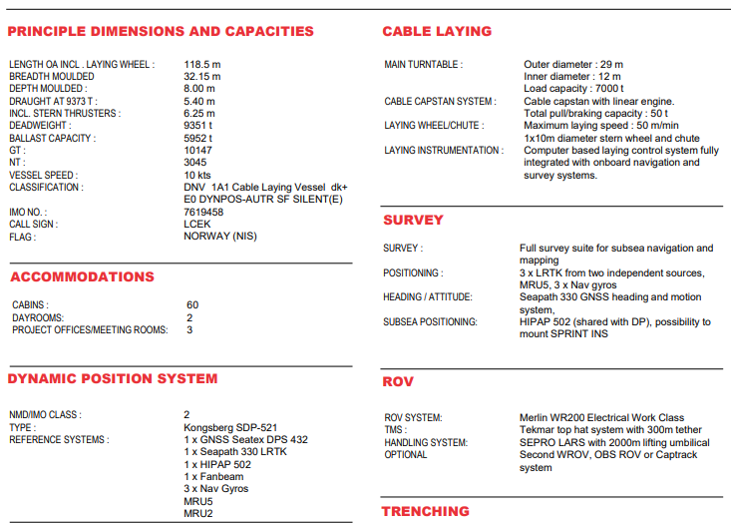
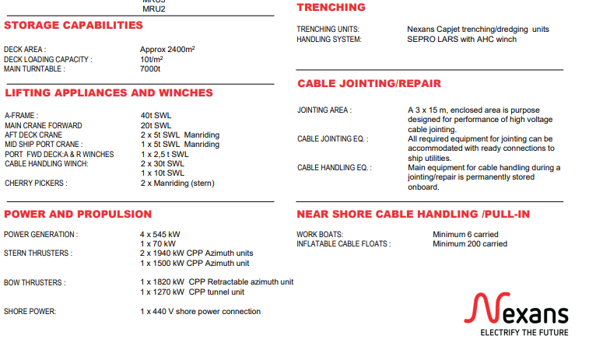
Skagerrak
Attica-crete survey/method statement

Slide 7
Thank you

